Slide 1
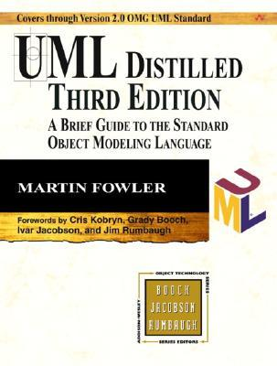
CSE 403
Design and UML Class Diagrams
Reading:
UML Distilled Ch. 3, by M. Fowler
These lecture slides are copyright (C) Marty Stepp, 2007. They may not be rehosted, sold, or modified without expressed permission from the author. All rights reserved.
‹#›
Notes:
‹#›

Slide 2
Big questions
What is UML?
Why should I bother? Do people really use UML?
What is a UML class diagram?
What kind of information goes into it?
How do I create it?
When should I create it?
‹#›

Slide 3
Design phase
design: specifying the structure of how a software system will be written and function, without actually writing the complete implementation
a transition from "what" the system must do, to "how" the system will do it
What classes will we need to implement a system that meets our requirements?
What fields and methods will each class have?
How will the classes interact with each other?
‹#›

Slide 4
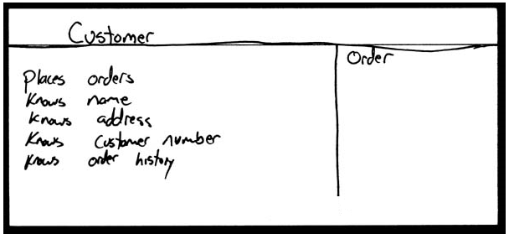
How do we design classes?
class identification from project spec / requirements
nouns are potential classes, objects, fields
verbs are potential methods or responsibilities of a class
CRC card exercises
write down classes' names on index cards
next to each class, list the following:
responsibilities: problems to be solved; short verb phrases
collaborators: other classes that are sent messages by this class (asymmetric)
UML diagrams
class diagrams (today)
sequence diagrams
...
‹#›

Slide 5
Introduction to UML
UML: pictures of an OO system
programming languages are not abstract enough for Object Oriented design
UML is an open standard; lots of companies use it
What is legal UML?
a prescriptive language: rigid formal syntax (like programming)
a descriptive language: shaped by usage and convention
it's okay to omit things from UML diagrams if they aren't needed by team/supervisor/instructor
‹#›

Slide 6
Uses for UML
as a sketch: to communicate aspects of system
forward design: doing UML before coding
backward design: doing UML after coding as documentation
often done on whiteboard or paper
used to get rough selective ideas
as a blueprint: a complete design to be implemented
sometimes done with CASE (Computer-Aided Software Engineering) tools
as a programming language: with the right tools, code can be auto-generated and executed from UML
only good if this is faster than coding in a "real" language
‹#›

Slide 7
UML class diagrams
What is a UML class diagram?
What are some things that are not represented in a UML class diagram?
UML class diagram: a picture of the classes in an OO system, their fields and methods, and connections between the classes that interact or inherit from each other
details of how the classes interact with each other
algorithmic details; how a particular behavior is implemented
‹#›

Slide 8
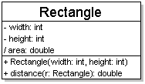
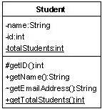
Diagram of one class
class name in top of box
write <<interface>> on top of interfaces' names
use italics for an abstract class name
attributes (optional)
should include all fields of the object
operations / methods (optional)
may omit trivial (get/set) methods
but don't omit any methods from an interface!
should not include inherited methods
‹#›

Slide 9
Class attributes
attributes (fields, instance variables)
visibility name : type
visibility: + public # protected - private ~ package (default) / derived
underline static attributes
derived attribute: not stored, but can be computed from other attribute values
attribute example: - balance : double = 0.00
‹#›

Slide 10
Class operations / methods
operations / methods
visibility name (parameters) : return_type
visibility: +public # protected - private ~ package (default)
underline static methods
parameter types listed as (name: type)
omit return_type on constructors and when return type is void
method example: + distance(p1: Point, p2: Point): double
‹#›

Slide 11
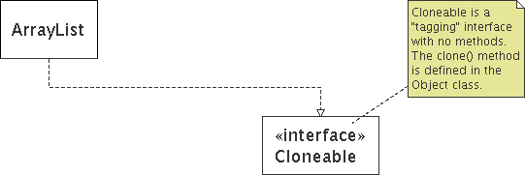
Comments
represented as a folded note, attached to the appropriate class/method/etc by a dashed line
‹#›

Slide 12
Relationships btwn. classes
generalization: an inheritance relationship
inheritance between classes
interface implementation
association: a usage relationship
dependency
aggregation
composition
‹#›

Slide 13
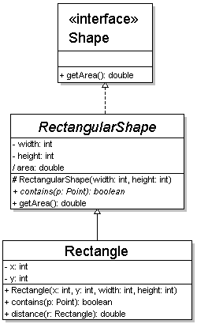
Generalization relationships
generalization (inheritance) relationships
hierarchies drawn top-down with arrows pointing upward to parent
line/arrow styles differ, based on whether parent is a(n):
class: solid line, black arrow
abstract class: solid line, white arrow
interface: dashed line, white arrow
we often don't draw trivial (less important class) / obvious generalization relationships, such as drawing the Object class as a parent
‹#›

Slide 14
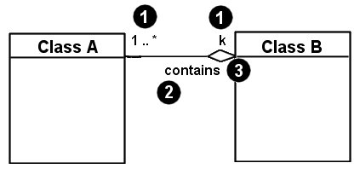
Associational relationships
associational (usage) relationships
1. multiplicity (how many are used)
* ⇒ 0, 1, or more
1 ⇒ 1 exactly
2..4 ⇒ between 2 and 4, inclusive
3..* ⇒ 3 or more
2. name (what relationship the objects have)
3. navigability (direction)
‹#›

Slide 15
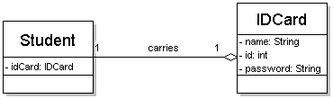
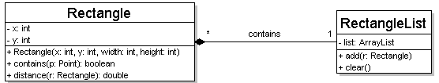
Multiplicity of associations
one-to-one
each student must carry exactly one ID card
one-to-many
one rectangle list can contain many rectangles
‹#›

Slide 16
Association types
Car
1
1
aggregation
aggregation: "is part of"
symbolized by a clear white diamond
composition: "is entirely made of"
stronger version of aggregation
the parts live and die with the whole
symbolized by a black diamond
dependency: "uses temporarily"
symbolized by dotted line
often is an implementation detail, not an intrinsic part of that object's state
Engine
Book
composition
1
*
Page
dependency
Lottery Ticket
Random
‹#›

Slide 17
Class diagram example 2
Multiplicity
Customer
1
Simple
Aggregation
Class
Abstract
Class
Rental Invoice
Rental Item
1..*
1
0..1
Composition
Simple
Association
Generalization
Checkout Screen
DVD Movie
VHS Movie
Video Game
‹#›

Slide 18
Tools for creating UML diags.
Violet (free)
http://horstmann.com/violet/
Rational Rose
http://www.rational.com/
Visual Paradigm UML Suite (trial)
http://www.visual-paradigm.com/
(nearly) direct download link: http://www.visual-paradigm.com/vp/download.jsp?product=vpuml&edition=ce
(there are many others, but most are commercial)
‹#›

Slide 19
Class design exercise
Consider this Texas Hold 'em poker game system:
2 to 8 human or computer players
Each player has a name and stack of chips
Computer players have a difficulty setting: easy, medium, hard
Summary of each hand:
Dealer collects ante from appropriate players, shuffles the deck, and deals each player a hand of 2 cards from the deck.
A betting round occurs, followed by dealing 3 shared cards from the deck.
As shared cards are dealt, more betting rounds occur, where each player can fold, check, or raise.
At the end of a round, if more than one player is remaining, players' hands are compared, and the best hand wins the pot of all chips bet so far.
What classes are in this system? What are their responsibilities? Which classes collaborate?
Draw a class diagram for this system. Include relationships between classes (generalization and associational).
‹#›

